Slide 1
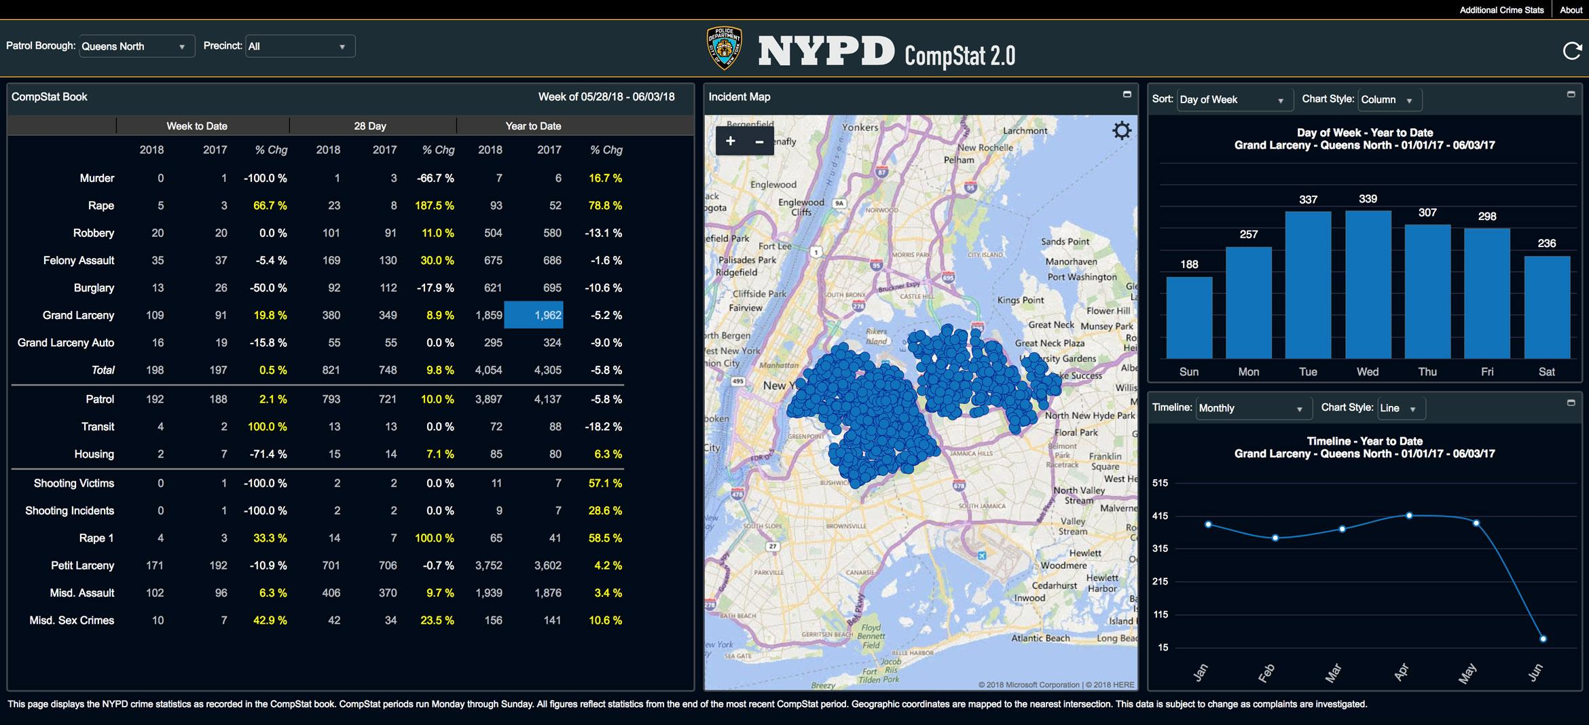
STS.047
Quantify and Punish:
Data, Race, and Policing
From the Burgess Method to Big Data
Module 11
© NYPD. All rights reserved. This content is excluded from our Creative Commons license. For more information, see https://ocw.mit.edu/help/faq-fair-use/

Slide 2

Logistics
For next Thursday: come prepared to give a brief (3/5 minute) presentation on an empowering work of recent social science
Individually or in pairs (if in pairs, both partners should talk, presentation should be proportionally longer)
Slides/visuals optional…
Post links on Canvas board
© NYPD. All rights reserved. This content is excluded from our Creative Commons license. For more information, see https://ocw.mit.edu/help/faq-fair-use/

Slide 3
Today’s Plan
Statistics, policing, and racial injustice: an overview
Crime statistics and the “condemnation of blackness,” c. 1890-1940
Risk assessment and the “actuarial” approach to policing and punishment, from the Burgess Method (1928) to AI
“Data-driven” policing from CompStat (1990s) to Big Data
© NYPD. All rights reserved. This content is excluded from our Creative Commons license. For more information, see https://ocw.mit.edu/help/faq-fair-use/

Slide 4
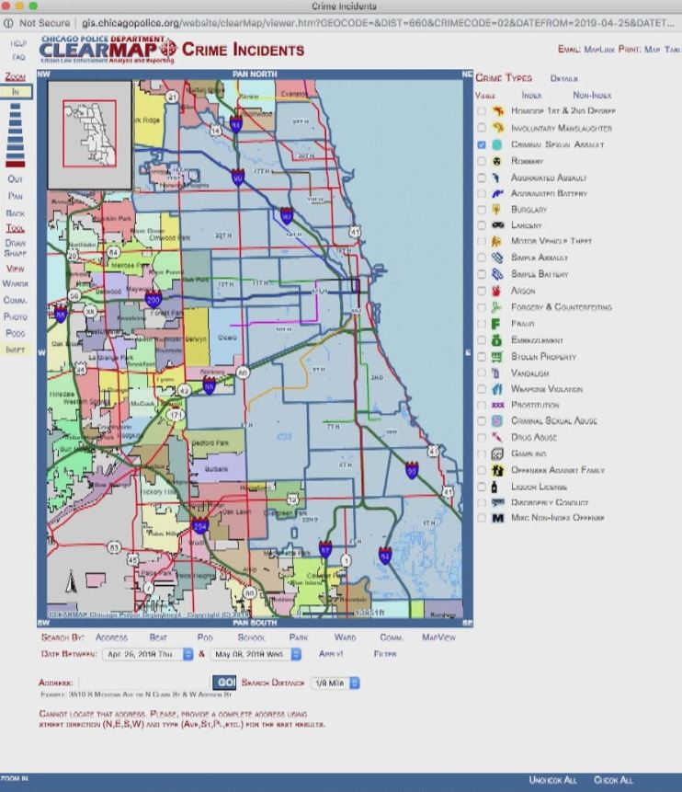
Quantify and Punish: Overview
Module 11 considers: what role have quantitative data, computational methods, and social science played in the construction of modern systems of criminal justice?
How has quantification contributed to the injustices of modern policing and punishment – to the creation and maintenance of a system that disproportionately and unjustly targets, punishes, incarcerates, and kills people of color, especially Black citizens?
What can history tell us about the role that data and computation should – or should not – play in efforts to create a more just system of justice in the future?
© Chicago Police Department. All rights reserved. This content is excluded from our Creative Commons license. For more information, see https://ocw.mit.edu/help/faq-fair-use/

Slide 5
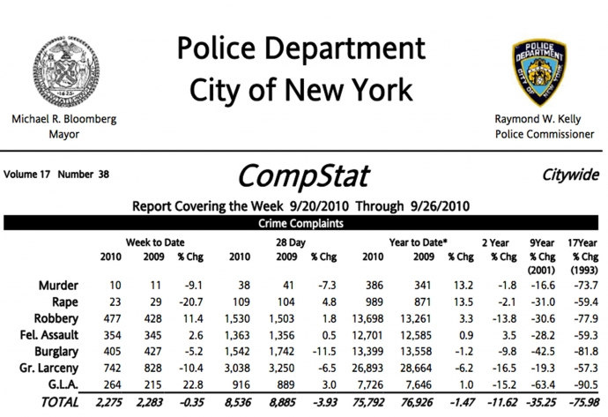
Quantification-Race-Policing: Big Themes
Turn to data and quantification often driven by desire to create fairer, more accountable, less biased systems – often in response to crisis, calls for reform
While quantitative turn has brought some positive effects and reforms, it has also brought harms
Efforts to quantify policing and punishment rely on historical data, which reflect biases of previous system – histories of data shape their futures
Data is always already mediated through previous criminal justice apparatus – the crime data” is in fact always “policing data”
© NYPD. All rights reserved. This content is excluded from our Creative Commons license. For more information, see https://ocw.mit.edu/help/faq-fair-use/

Slide 6
Quantification-Race-Policing: Big Themes
In fact, data has played a central role in the historical construction of ideas about criminality that undergird structural racism of modern criminal justice system
Computational tools can obscure, launder, and exacerbate existing patterns of discrimination – behind veil of “objectivity”
The establishment of quantitative systems for guiding and evaluating policing can reshape policing behaviors in detrimental ways:
“Ratchet effects”
“Juking the stats”
© NYPD. All rights reserved. This content is excluded from our Creative Commons license. For more information, see https://ocw.mit.edu/help/faq-fair-use/

Slide 7
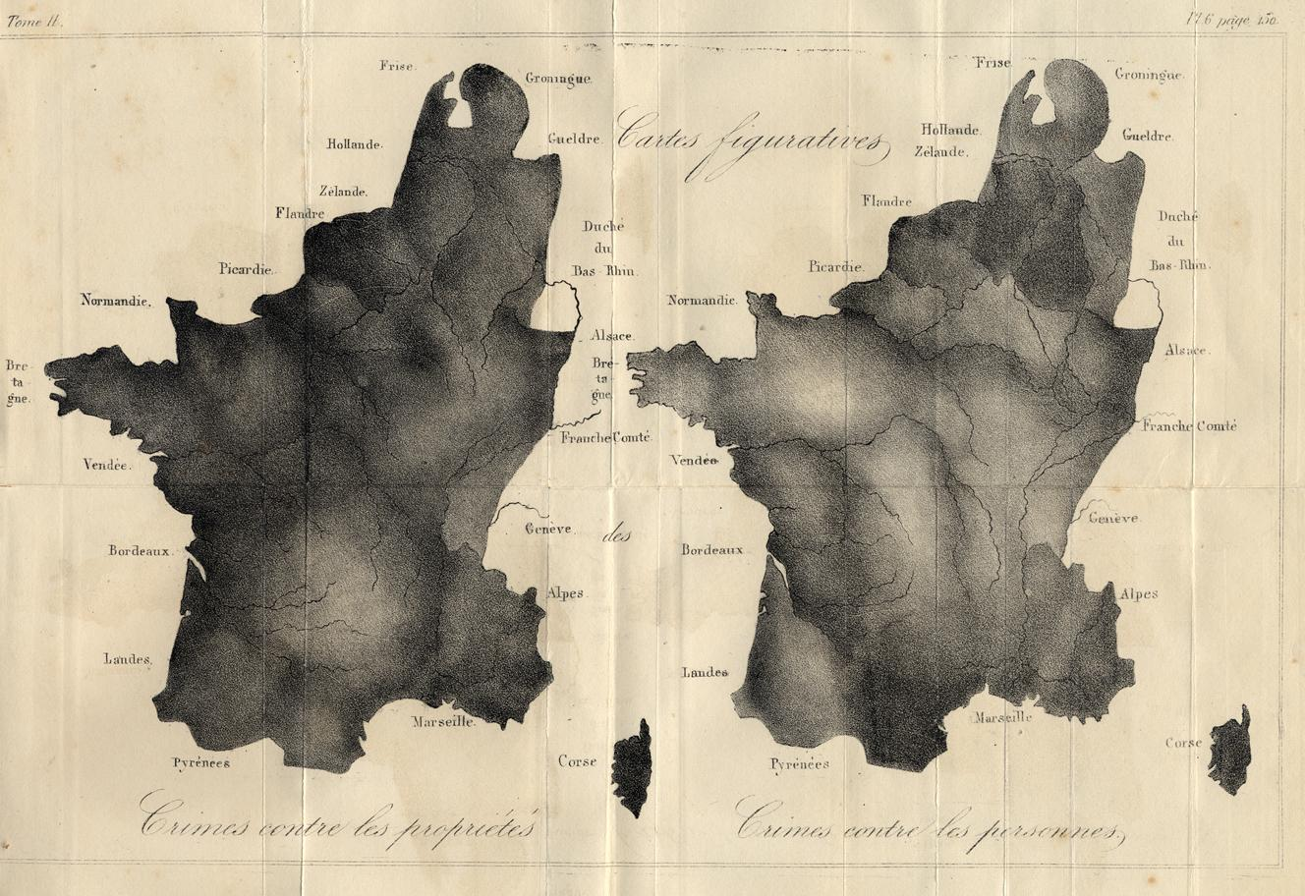
Crime, Numbers, and Social Science
Image is in the public domain.
“Cartes figurative: Crimes contre les propriétés / Crimes contre les personnes.” Two lithograph maps within one border, 21.5 × 33 cm. From Quetelet’s Sur l’homme et le développement de ses facultés; ou, Essai de physique sociale, 2 vols. in 1 (Brussels: Louis Hauman, 1836) [Historic Maps Collection]. (Princeton Historical Maps Collection)

Slide 8
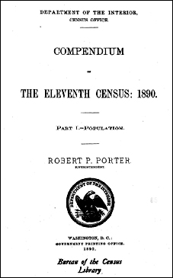

Three Episodes
Crime statistics and the “condemnation of blackness,” c. 1890-1940
Risk assessment and the “actuarial” approach to policing and punishment, from the Burgess Method (1928) to AI
“Data-driven” policing from CompStat (1990s) to Big Data
Image is in the public domain.
© Northpointe, NYPD. All rights reserved. This content is excluded from our Creative Commons license. For more information, see https://ocw.mit.edu/help/faq-fair-use/

Slide 9
Crime statistics and the “condemnation of blackness,” c. 1890-1940

Slide 10
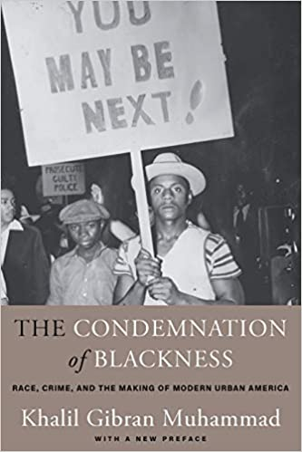
The Statistical Condemnation of Blackness
In 2011 book, Khalil Gibran Muhammad argues that statistics played a crucial role in the establishing a link between Blackness and criminality
Notion that criminality was a feature of Black Americans as a group, while crime by white Americans was masked as individual failure
“Black criminality [became] the most significant and durable signifier of black inferiority in white people’s minds” (p. 3)
Gibran argues this link was forged in the Jim Crow era (1890-1940)
© Khalil Gibran Muhammad/Harvard University Press. All rights reserved. This content is excluded from our Creative Commons license. For more information, see https://ocw.mit.edu/help/faq-fair-use/

Slide 11
The 1890 Census
1890 Census was a watershed moment
Context: 25 years after emancipation; more than a decade after end of Reconstruction – question of status and future of African Americans in American society
1890 census publicized data about prison populations by race: Black Americans were 12% of population and 30% of prisoners
Statistical racists like Frederick T. Hoffman (Module 7) drew heavily on 1890
Image is in the public domain.

Slide 12
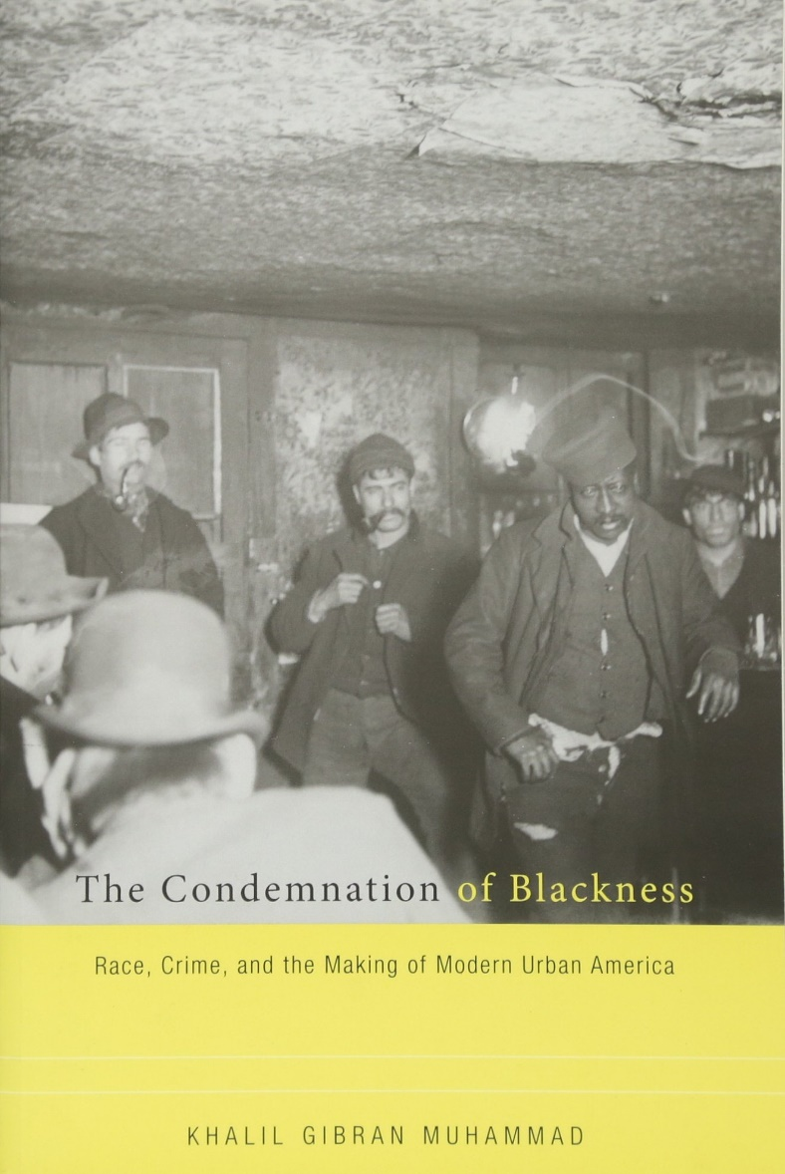
Comparing Black and Foreign-Born
Crucial to the creation of what Muhammad calls the “statistical ghetto” was comparison between Black and foreign-born white Americans
Progressive era social scientists interpreted (or dismissed) statistics on crime by European immigrants as evidence that Irish, Italians, Poles, etc. could be assimilated into US culture
Charles R. Henderson, U. Chicago sociologist, 1901: “the [evil of immigrant crime] is not so great as statistics carelessly interpreted might prove…”
© Khalil Gibran Muhammad/Harvard University Press. All rights reserved. This content is excluded from our Creative Commons license. For more information, see https://ocw.mit.edu/help/faq-fair-use/

Slide 13
Comparing Black and Foreign-Born
Henderson (1901), cont’d: But where the “Negro factor” is concerned, “racial inheritance, physical and mental inferiority, barbarian and slave ancestry and culture…” were among the “most serious factors in crime statistics.”
© Khalil Gibran Muhammad/Harvard University Press. All rights reserved. This content is excluded from our Creative Commons license. For more information, see https://ocw.mit.edu/help/faq-fair-use/

Slide 14
Risk assessment and the “actuarial” approach to policing and punishment, from the Burgess Method (1928) to AI

Slide 15
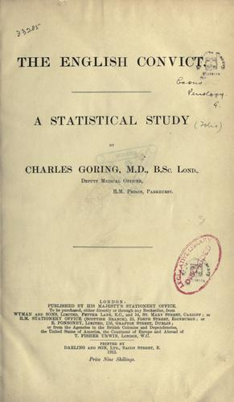
“Positive Criminology” & “Individualization”
Key finding of 19th c. quantitative soc. sci. was regularity of “laws” of crime – Quetelet’s “budget of the scaffold”
Crime was not random, but predictably steady
Advocates of “positive criminology” like Cesare Lombroso (1835-1909) and Charles Goring (1870-1919) held criminals were not randomly chosen from population
Criminality seen to be correlated with home conditions, physical traits, genetic makeup, neighborhood, and race
This image is in the public domain.

Slide 16
“Positive Criminology” & “Individualization”
Circa 1900: international interest in the “individualization of penal treatment”
National Conference on Criminal Law and Criminology, 1909: U. Chicago law profs. Ernst Freund and Roscoe Pound set agenda:
“Modern science recognizes that penal or remedial treatment cannot possibly be indiscriminate and machine-like, but must be adapted to the causes, and to the man as affected by those causes”
This image is in the public domain.

Slide 17
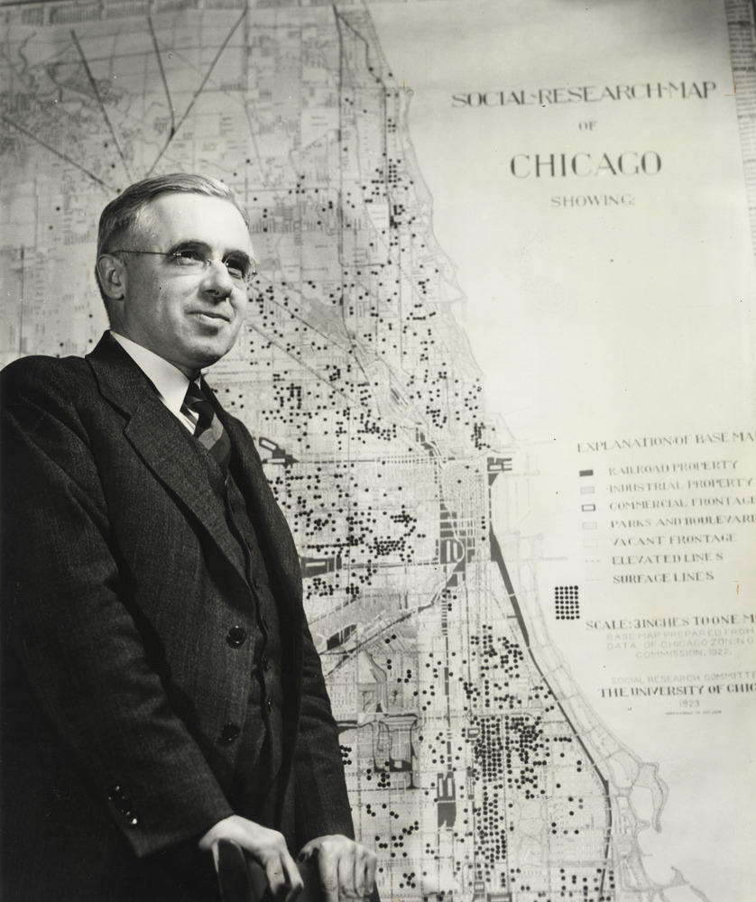
Ernest Burgess and Parole Prediction
Goal of “Individualization” encouraged move toward indeterminate sentencing for crimes: local parole boards to determine length of sentence
1920s: researchers like Hornell Hart (Iowa Child Research Station) argue that statistics might make it possible to create a “prognostic score for each man coming up for parole”
Robert Burgess (1886-1966): PhD in Sociology from U. Chicago in 1913; faculty 1916
Co-wrote Introduction to the Science of Sociology w. Chicago mentor Robert Park (1921)
Ernest W. Burgess photographed by Stephen Deutch, University of Chicago Photographic Archive, apf1-02325, Special Collections Research Center, University of Chicago Library.
© University of Chicago. All rights reserved. This content is excluded from our Creative Commons license. For more information, see https://ocw.mit.edu/help/faq-fair-use/

Slide 18
Ernest Burgess and Parole Prediction
Burgess emphasized quant. methods over “ecological” approach dominant at Chicago
Burgess: “Prediction is the aim of the social sciences as it is of the physical sciences.” (1929)
1927-28: Burgess and four colleagues requested by chairman of Illinois parole board to study Ill. procedures
Understaffed, overworked parole officials in Ill. had been unable to give much attention or deliberation to parole cases
Burgess conducts study of 3,000 parole cases in Illinois ~1920-1924
Ernest W. Burgess photographed by Stephen Deutch, University of Chicago Photographic Archive, apf1-02325, Special Collections Research Center, University of Chicago Library.
© University of Chicago. All rights reserved. This content is excluded from our Creative Commons license. For more information, see https://ocw.mit.edu/help/faq-fair-use/

Slide 19
Ernest Burgess and Parole Prediction
Burgess attempted to find a statistical relationship between who did/did not violate terms of parole and 22 other independent factors
Factors included: racial and ethnic categorization, social & personality type, mental age, circumstances of crime, and prior criminal record
Burgess develops 21-factor test: those with high scores (16-21) had low parole-offense rates (1.5%); those with low scores (2-4) had highest offending rates (76%)
Reading for this module…
Ernest W. Burgess photographed by Stephen Deutch, University of Chicago Photographic Archive, apf1-02325, Special Collections Research Center, University of Chicago Library.
© University of Chicago. All rights reserved. This content is excluded from our Creative Commons license. For more information, see https://ocw.mit.edu/help/faq-fair-use/

Slide 20
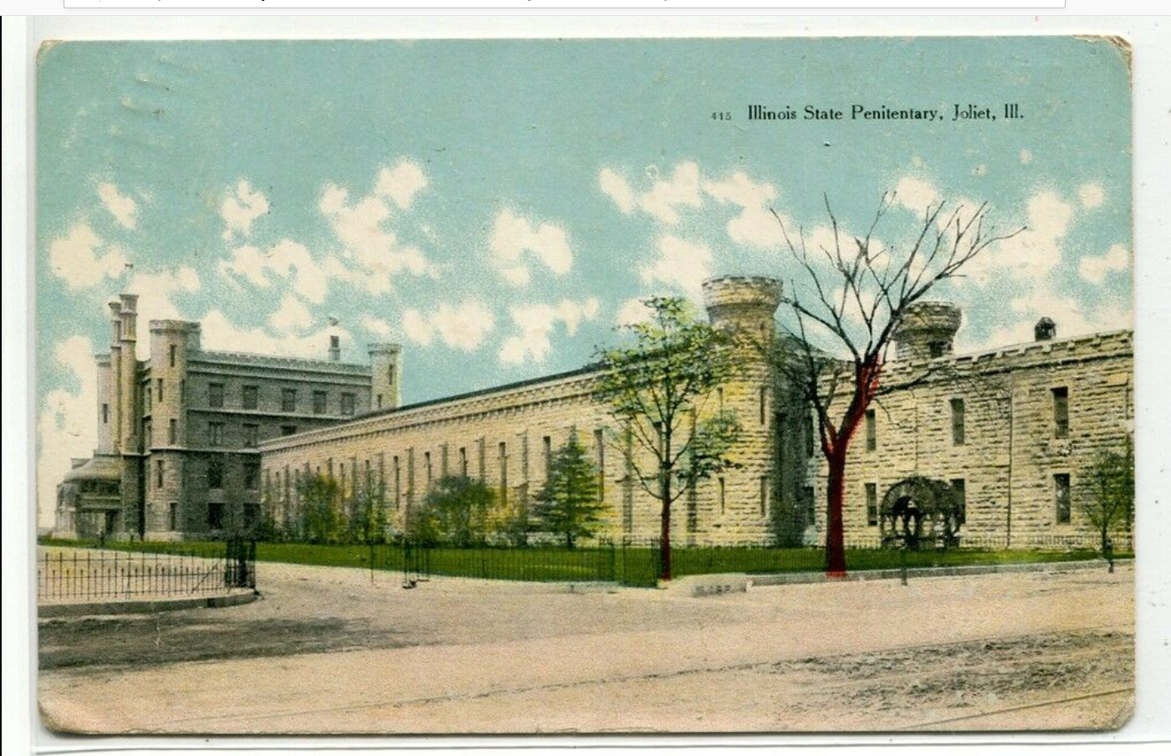
The Burgess Method Takes Hold
Burgess Method implemented quickly at Joliet Penitentiary, 1932-33
1932 election: Democratic wave leads to Dem. Governor elected in IL; appoints John Landesco, Burgess’s research assistant, to State Parole Board
Landesco urges IL legislature to pass bill to hire sociologists and actuaries to “make analyses and predictions in the cases of all men being considered for parole”
1930s-40s: Adoption of Burgess Method in IL triggers outpouring of academic research
Illinois State Penitentiary, Joliet (Source)
© Source unknown. All rights reserved. This content is excluded from our Creative Commons license. For more information, see https://ocw.mit.edu/help/faq-fair-use/

Slide 21
The Burgess Method Takes Hold
Others seek to critique, improve Burgess Method through more data and development of new risk-assessment tools using different variables and weighting different variables more/less
Some explored more sophisticated statistical techniques (e.g. multiple regression) to develop assessment tools
Researchers studying Burgess Method found prominent positions at top institutions like U. Chicago, Harvard Law School, University of Southern California, and University of Minnesota
Illinois State Penitentiary, Joliet (Source)
© Source unknown. All rights reserved. This content is excluded from our Creative Commons license. For more information, see https://ocw.mit.edu/help/faq-fair-use/

Slide 22
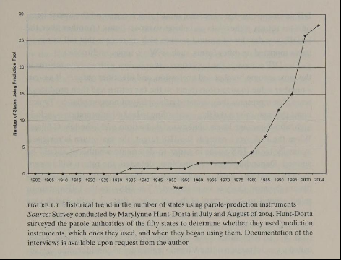
The Actuarial Approach Takes Off
For the first few decades, application actuarial parole methods confined to Illinois
Other states begin to adopt similar tools in 1960s
Prior to 1970s, race and nationality were common factors in these tools
Early 1970s: federal gov’t adopts slim, 7-factor “Salient Factor Score”
Federal adoption stimulates widespread interest in parole prediction tools – first in California, then wave of other states in the 1980s-90s
From Harcourt, Against Prediction: Policing, Punishing, and Profiling in an Actuarial Age (Chicago, 2007), p. 9.
© Bernard Harcourt. All rights reserved. This content is excluded from our Creative Commons license. For more information, see https://ocw.mit.edu/help/faq-fair-use/

Slide 23
The Actuarial Approach Takes Off
From Harcourt, Against Prediction: Policing, Punishing, and Profiling in an Actuarial Age (Chicago, 2007), p. 9.
© Bernard Harcourt. All rights reserved. This content is excluded from our Creative Commons license. For more information, see https://ocw.mit.edu/help/faq-fair-use/

Slide 24
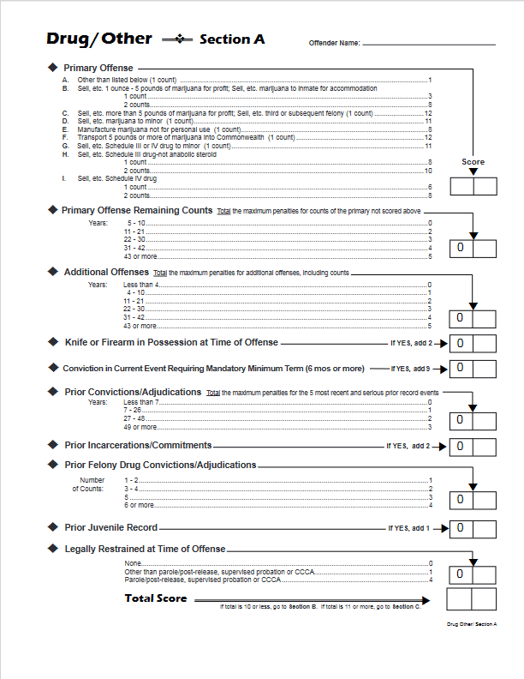
Example of a criminal sentencing worksheet from the Virginia Criminal Sentencing Commission (Source)
© Commonwealth of Virginia. Virginia Criminal Sentencing Commission.. All rights reserved. This content is excluded from our Creative Commons license. For more information, see https://ocw.mit.edu/help/faq-fair-use/

Slide 25
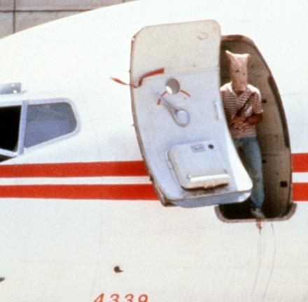
From Parole Prediction to Profiling
By 1951, Burgess argued actuarial risk assessment could be applied much more widely than parole selection
Later part of the 20th century saw adoption of risk-assessment methods to policing potential crimes as well (“profiling”)
1968: Federal Aviation Administration implements “airline-highjacker” profile – 25 characteristics
1970s+: increasing use of profiles for specific crimes “drug-courier”
Image from hijacking of TWA flight 847, 1985 (CNN)
© JOEL ROBINE/AFP/Getty Images. All rights reserved. This content is excluded from our Creative Commons license. For more information, see https://ocw.mit.edu/help/faq-fair-use/

Slide 26
From Parole Prediction to Profiling
Starting in 1969, IRS began to use computerized assessment of past income tax returns to develop predictive tools (secret “Discriminant Index Function”) to flag income tax return for audit
Image from hijacking of TWA flight 847, 1985 (CNN)
© JOEL ROBINE/AFP/Getty Images. All rights reserved. This content is excluded from our Creative Commons license. For more information, see https://ocw.mit.edu/help/faq-fair-use/

Slide 27
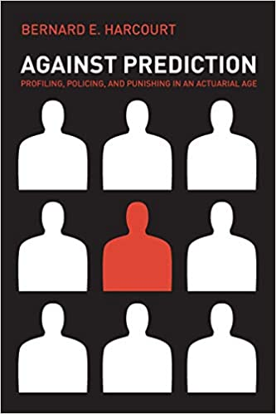
Social Costs of Prediction: the “Ratchet”
Legal scholar Bernard Harcourt and others have identified crucial social costs to the actuarial, predictive approach to criminal justice
Using statistical techniques to target policing/ punishment will increase success rate of searches, audits, parole decisions, etc.
More searches (of specific group) will find more contraband…
More parole denials (of specific group) will prevent re-offenses…
© Bernard Harcourt, University of Chicago Press. All rights reserved. This content is excluded from our Creative Commons license. For more information, see https://ocw.mit.edu/help/faq-fair-use/

Slide 28
Social Costs of Prediction: the “Ratchet”
If the actuarial methods disproportionately target a specific group – e.g. drywall contractors for tax audits, young Black men for street frisks – then over time the extra policing attention will produce more infractions from that group
This may be taken as confirmatory evidence that the specific group offends at a higher rate (not that the group is under heightened attention)
This creates a “ratchet”: increased police attention 🡪 more evidence of infractions 🡪 increased police attention 🡪 …
© Bernard Harcourt, University of Chicago Press. All rights reserved. This content is excluded from our Creative Commons license. For more information, see https://ocw.mit.edu/help/faq-fair-use/

Slide 29
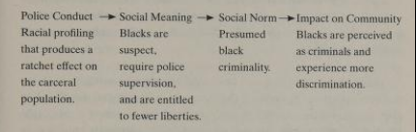
Social Costs of Prediction: the “Ratchet”
subject to police contacts, even with small/no punishment or for minor infractions, can have significant social costs
Harcourt: “Disproportionate criminal supervision and incarceration reduces work opportunities, breaks down families and communities, and disrupts education.” (161)
p. 163
© Bernard Harcourt, University of Chicago Press. All rights reserved. This content is excluded from our Creative Commons license. For more information, see https://ocw.mit.edu/help/faq-fair-use/

Slide 30
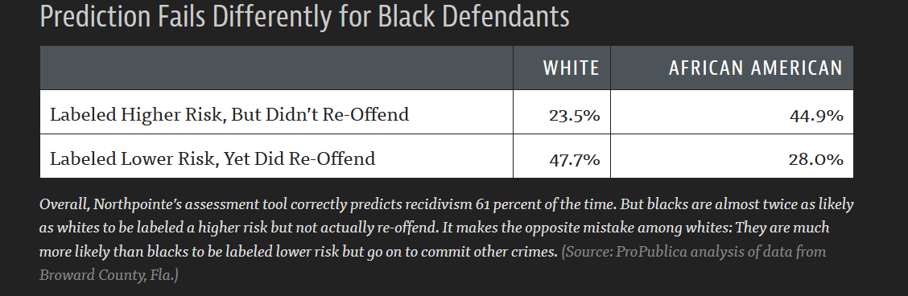
Algorithmic Predictions and Their Biases
Today, “risk assessment” for criminal sentencing and parole are increasingly conducted by algorithms
E.g. the COMPAS -- Correctional Offender Management Profiling for Alternative Sanctions – algorithm from for-profit company Northpointe
Algorithmic risk scores widely used in assigning bail, criminal sentencing, and parole decisions
As of 2016, risk scores given directly to judges during sentencing in at least 11 states
COMPAS algorithm based on 137 questions/data points; not race
© Northpointe. All rights reserved. This content is excluded from our Creative Commons license. For more information, see https://ocw.mit.edu/help/faq-fair-use/

Slide 31
Algorithmic Predictions and Their Biases
‘The survey asks defendants such things as: “Was one of your parents ever sent to jail or prison?” “How many of your friends/acquaintances are taking drugs illegally?” and “How often did you get in fights while at school?” The questionnaire also asks people to agree or disagree with statements such as “A hungry person has a right to steal” and “If people make me angry or lose my temper, I can be dangerous.”’
Julia Angwin, Jeff Larson, Surya Mattu and Lauren Kirchner, “Machine Bias,” ProPublica (May 23, 2016).
© Northpointe. All rights reserved. This content is excluded from our Creative Commons license. For more information, see https://ocw.mit.edu/help/faq-fair-use/

Slide 32
Algorithmic Predictions and Their Biases
2016 study by ProPublica found that COMPAS algorithm was…
…very bad at predicting violent crime: 20% of those predicted to commit future violent crime did
…only moderately good at predicting all crime (including misdemeanor): 61% of those deemed likely recidivists committed future crimes
…racially biased: Black defendants much more likely to be flagged incorrectly as likely re-offenders (false positive), and white defendants more likely to be mislabeled as low risk (false negative)
© Northpointe. All rights reserved. This content is excluded from our Creative Commons license. For more information, see https://ocw.mit.edu/help/faq-fair-use/
© Julia Angwin, Jeff Larson, Surya Mattu and Lauren Kirchner, ProPublica. All rights reserved. This content is excluded from our Creative Commons license. For more information, see https://ocw.mit.edu/help/faq-fair-use/

Slide 33
Algorithmic Predictions and Their Biases
© Julia Angwin, Jeff Larson, Surya Mattu and Lauren Kirchner, ProPublica. All rights reserved. This content is excluded from our Creative Commons license. For more information, see https://ocw.mit.edu/help/faq-fair-use/

Slide 34
“Data-driven” policing from CompStat (1990s) to Big Data

Slide 35
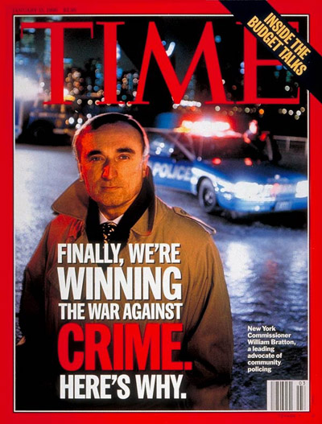
Bill Bratton and Data-Driven Policing
No single individual more responsible for expansion of “data-driven policing” than Bill Bratton
Across two stints as police chief in NYC and one in LA, Bratton led three major expansions of use of data and computation
Critically: in all three cases, Bratton was brought in to reform police depts. in crisis
In each case, Bratton turned to data and computation as a remedy for corruption, mal-practice, and bias
© TIME. All rights reserved. This content is excluded from our Creative Commons license. For more information, see https://ocw.mit.edu/help/faq-fair-use/

Slide 36
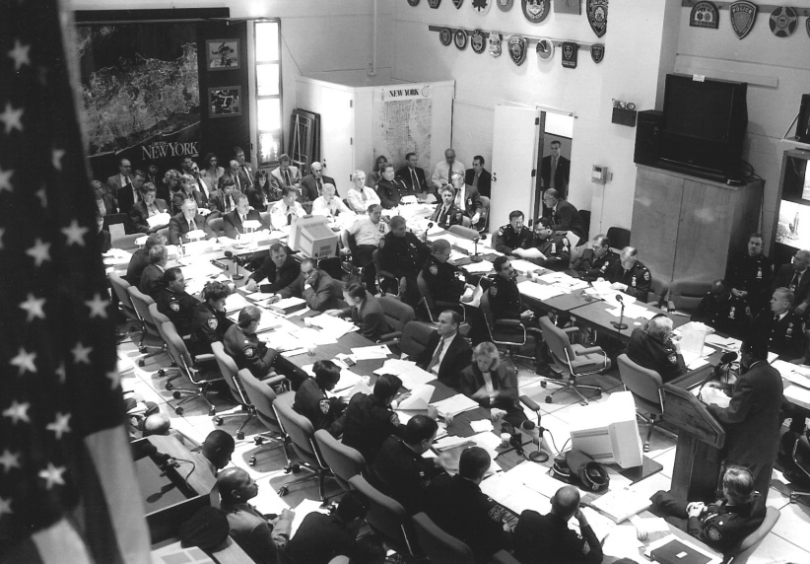
Compstat: Quantitative Policing in the ‘90s
Early 1990s, NYC experiencing high crime and raft of police corruption
Mollen Commission (created 1992) revealed widespread, unchecked corruption in NYPD: “characterized by brutality, theft, abuse of authority, and active police criminality.”
1994: Mayor Rudolph Giuliani appoints Bratton new Police Commissioner; previously Boston police chief and head of NYC Transit Police
As head of Transit Police, Bratton had overseen work of Jack Maple
https://www.innovations.harvard.edu/compstat-crime-reduction-management-tool
© Harvard. All rights reserved. This content is excluded from our Creative Commons license. For more information, see https://ocw.mit.edu/help/faq-fair-use/

Slide 37
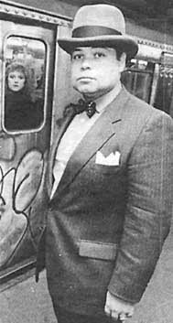
Jack Maple’s “Charts of the Future”
Jack Maple started in NYPD in 1970; became a transit police officer, inc. undercover Times Square / 42nd Street Station
In 1970s-80s, subways major sites of crime, esp. violent robberies
As detective, Maple took to mapping patterns of subway crime with pushpins on wall maps – “Chart of the Future”
Charts allowed Maple to observe repeated patterns in subways crimes – large %age of crimes from serial offenders tracing set routes
Targeting policing to key locations disrupted these patterns; led to 27% reduction in subway crime
Jack Maple (Source)
© unknown. All rights reserved. This content is excluded from our Creative Commons license. For more information, see https://ocw.mit.edu/help/faq-fair-use/

Slide 38
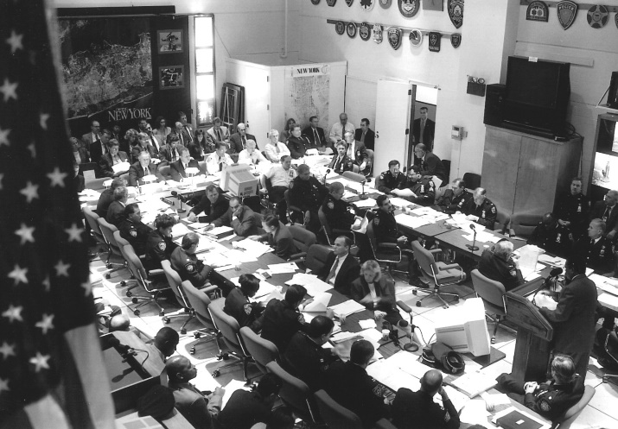
CompStat in Practice
When appointed Commissioner in 1994, Bratton promoted Maple from lieutenant to Deputy Chief
Maple and Bratton institute new COMPuterized STATistics program
CompStat required personnel from each of city’s 77 precincts and other units to submit weekly report on complaints, arrests, summons, open crimes, etc.
NYPD CompStat system produced regular reports showing weekly, monthly, annual trends
https://www.innovations.harvard.edu/compstat-crime-reduction-management-tool
© Harvard. All rights reserved. This content is excluded from our Creative Commons license. For more information, see https://ocw.mit.edu/help/faq-fair-use/

Slide 39
CompStat in Practice
Systems of regular meetings with leading NYPD officials and precinct/unit commanders enabled sharing of data, discussion of crime control strategies, and oversight of units
One key objective of CompStat including improving accountability and professionalism of local force while giving more responsibility to local commanders
Also sought to address problems of inadequate police attention in certain areas: e.g. major crimes in poor, predominantly Black and Latinx areas outside Manhattan core went routinely unsolved
https://www.innovations.harvard.edu/compstat-crime-reduction-management-tool
© Harvard. All rights reserved. This content is excluded from our Creative Commons license. For more information, see https://ocw.mit.edu/help/faq-fair-use/

Slide 40
The “Marvel” of CompStat
Institution of CompStat coincided with notable decline in crime in New York City – inc. stark decline in murders, from record 2,245 in 1990 to 673 in 2000 (and 289 in 2018)
Bratton publicly targeted 10%+ reductions in crime; achieved 12% in first CompStat years
NYT called results under Bratton “marvel of modern law enforcement”; “simply breathtaking”
But debate over role of CompStat in decline in crime (decline began in 1990, before CompStat, and occurred across major cities)
© TIME. All rights reserved. This content is excluded from our Creative Commons license. For more information, see https://ocw.mit.edu/help/faq-fair-use/

Slide 41
The “Marvel” of CompStat
Apparent successes of CompStat in New York led to widespread uptake of data-driven methods across other US police departments over early 2000s, inc. Philadelphia, Miami, Chicago, Baltimore, DC, San Francisco, etc.
2002: Bratton recruited to lead Los Angeles PD; wracked by longstanding abuses, poor community relations, poor morale, and major corruption scandal in anti-gang unit (“Rampart Scandal”)
Bratton instituted CompStat in LA
© TIME. All rights reserved. This content is excluded from our Creative Commons license. For more information, see https://ocw.mit.edu/help/faq-fair-use/

Slide 42
The “Marvel” of CompStat
For opposing perspectives on the role of CompStat in crime decline:
Lauren-Brooke Eisen, Oliver Roeder, and Julia Bowling, “What Caused the Crime Decline?” The Brennan Center for Justice (Feb. 12, 2015)
Steven D. Levitt, “Understanding Why Crime Fell in the 1990s: Four Factors that Explain the Decline and Six That Do Not,” Journal of Economic Perspectives 18, no. 1 (Winter 2004): 163-190.
© TIME. All rights reserved. This content is excluded from our Creative Commons license. For more information, see https://ocw.mit.edu/help/faq-fair-use/

Slide 43
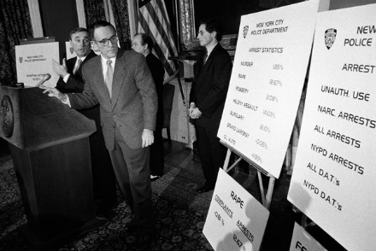
“Juking the Stats”: Critiques of CompStat
Introduction of CompStat had major effects on practice and culture of policing
Increasing political, managerial emphasis on reducing CompStat numbers created pressure on commanders and officers to make it appear crime was falling
Emphasis on measurable stats distracted from public safety goals, community relationships
“Juking the Stats”: statistical manipulation designed to make CompStat figures appear better: e.g. through reclassifying crimes into lesser categories (aggravated assaults 🡪 assaults)
Mayor Rudolph W. Giuliani, right, and Police Commissioner William Bratton at a 1995 news conference reporting a decline in crime statistics.James Estrin for The New York Times. https://archive.nytimes.com/www.nytimes.com/interactive/2013/12/06/nyregion/bratton-on-the-issues.html - /
© James Estrin/The New York Times. All rights reserved. This content is excluded from our Creative Commons license. For more information, see https://ocw.mit.edu/help/faq-fair-use/

Slide 44
“Juking the Stats”: Critiques of CompStat
Rewarding measurable indicators of police activity – e.g. arrests and tickets – incentivized officers to increase punishment for minor offenses (e.g. transit fare evasion, vandalism, loitering)
Especially combined with “broken windows” theory (as in Bratton in the 90s): theory that rigorously policing minor “anti-social” crimes creates environment of order, lawfulness that prevents more serious crime
Black and Latino citizens dis-proportionately targets of minor-crime enforcement: 2001-2013, Blacks and Latinos in NY (57% of population) were 80% of misdemeanor arrests and summonses
© James Estrin/The New York Times. All rights reserved. This content is excluded from our Creative Commons license. For more information, see https://ocw.mit.edu/help/faq-fair-use/

Slide 45

“Juking the Stats”
The Wire, Season 4, Episode 9 (2006).

Slide 46
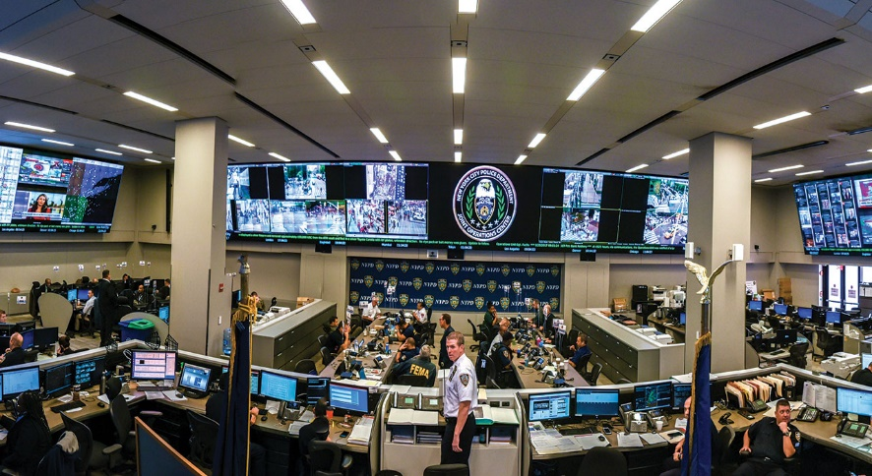
The Rise of Big Data Policing in the 2000s
Bratton returned as NYPD chief Jan. 1, 2014 – in wake of widespread anger about “stop-and-frisk” and legal ruling declaring it unconstitutional
Bratton oversees construction of real-time crime-command center in Manhattan; orders tens of thousands of crime mapping tablet computers
“Intelligence-led policing” purported to go beyond “hunches,” offer alternative to stop and frisk
NYPD Joint Operations Center (City Journal)
© Victor Milsoslvsky/NYPD. All rights reserved. This content is excluded from our Creative Commons license. For more information, see https://ocw.mit.edu/help/faq-fair-use/

Slide 47
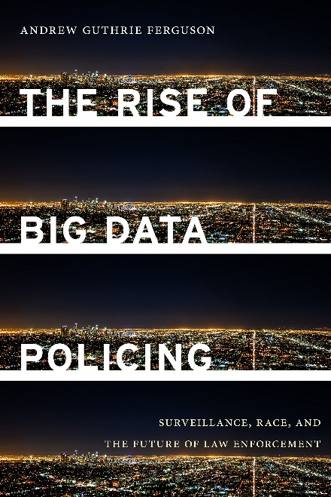
Data & the Who/Where/When/How of Policing
Whom…
In 2012, Kansas City PD used social-network analysis to identify 884 people deemed likely to commit homicides 🡪 “focused deterrence”
Chicago developed algorithmic “heat list” to identify likely perpetrators and victims of gum violence
Where…
Jeff Brantingham (UCLA) uses earthquake-prediction techniques to develop PredPol algorithm for identifying likely sites of crime 🡪 implemented by LAPD in 2011 (25% reduction in burglaries)

Slide 48
Data & the Who/Where/When/How of Policing
When…
Networks of surveillance devices (cameras, license plate readers, etc.) used for real-time tracking and alerts; e.g. NYPD-Microsoft “Domain Awareness system” monitoring southern Manhattan
How…
Data mining to search “cellular, digital, and biological data trails”
Facial recognition
Notably, much of this done in concert with private for-profit companies – as in Palantir and LAPD Real-Time Analysis Critical Response section

Slide 49
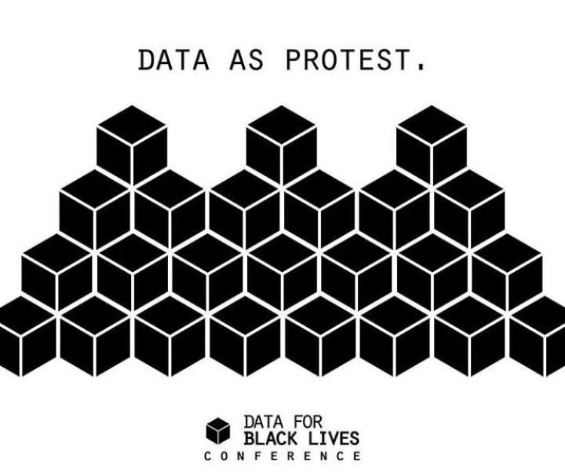
The Future of Big Data and Policing?
Andrew Guthrie Ferguson proposes five-point checklist for safe application of big data techniques:
Can you identify the risks your technology is trying to address?
Can you defend the inputs into the system?
Can you defend the outputs (how they will impact policing practice/community)?
Can you test the technology (transparency/accountability)?
Is police use of the technology respectful of the autonomy of the people it will impact?
Or, abolish big data? (Data for Black Lives)
© Data for Black Lives. All rights reserved. This content is excluded from our Creative Commons license. For more information, see https://ocw.mit.edu/help/faq-fair-use/

Slide 50
MIT OpenCourseWare
https://ocw.mit.edu
RES.TLL-008 Social and Ethical Responsibilities of Computing (SERC)
Fall 2021
For information about citing these materials or our Terms of Use, visit: https://ocw.mit.edu/terms

